Slide 1
Analysis of Housing Price Trends in Gurgaon
A Comprehensive Study Based on Key Housing Features

Slide 2


Introduction
Importance of the Study –
Insight into market trends.
Useful for real estate investments and pricing strategies.
Purpose Of The Dashboard –
Understanding the price rise of houses in Gurgaon over time.
Key factors: number of bedrooms, bathrooms, waterfront presence, and house condition.

Slide 3

Data Overview
Key Matrices Analyzed -
Price over time
Number of bedrooms
Number of bathrooms
Waterfront presence
House condition
Histogram of price

Slide 4
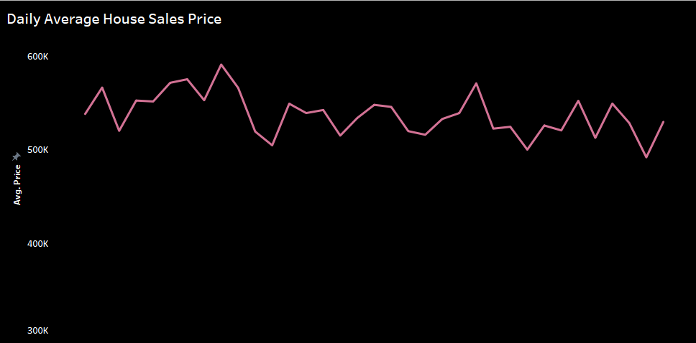
Price Trends Over Time (Visualization: Line Chart showing Price Over Time)
Insights:
- Overall trend of housing prices.
- Significant spikes or drops and possible
reasons.

Slide 5
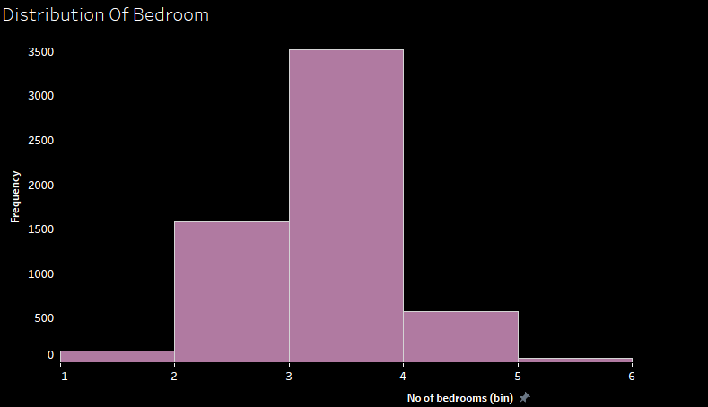
Frequency Of Number of Bedrooms (Visualization: Histogram Of Number of Bedrooms)
Insights:
- Distribution of bedrooms.

Slide 6
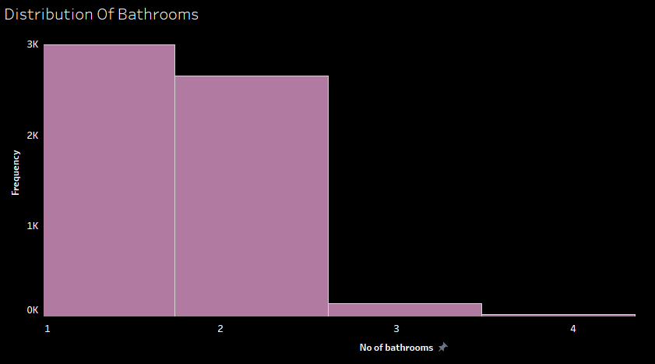
Frequency Of Number of Bathrooms (Visualization: Histogram Of Number of Bathrooms)
Insights:
- Distribution of bathrooms.

Slide 7
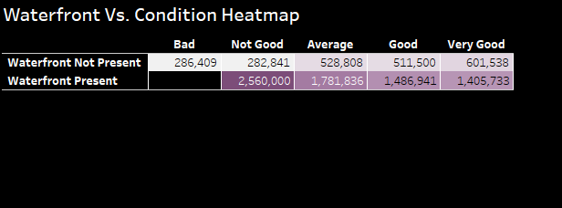
Price Based On Waterfront & Condition (Visualization: Heat Map Of Price Against Waterfront & Condition Of House)
Insights:
- Price difference based on waterfront
presence.
- How house condition affects price.
- Analysis of waterfront premium.

Slide 8
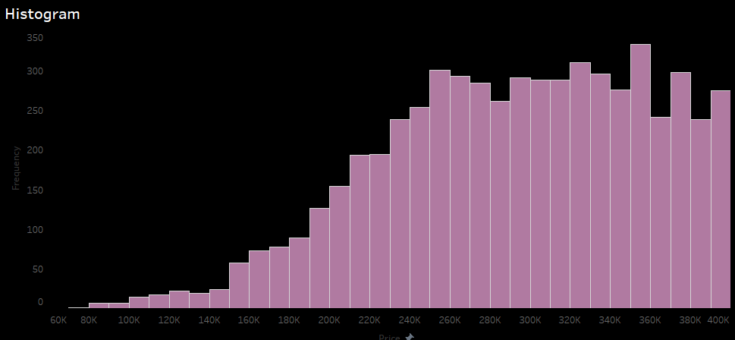
Histogram of Housing Prices (Visualization: Histogram showing Distribution of Housing Prices)
Insights:
- Overall distribution of prices.
- Identifying price ranges and outliers.

Slide 9
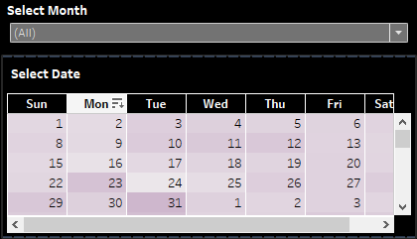
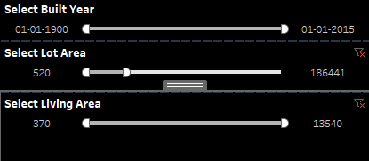
Filters
1
To find the insights from the above mentioned visualization we can select a particular month and we can check the trend for a date or a range of time.
2
We can check the trend of price, distribution of bathrooms, bedrooms and price based on Built Year, Lot Area and Living Area.

Slide 10
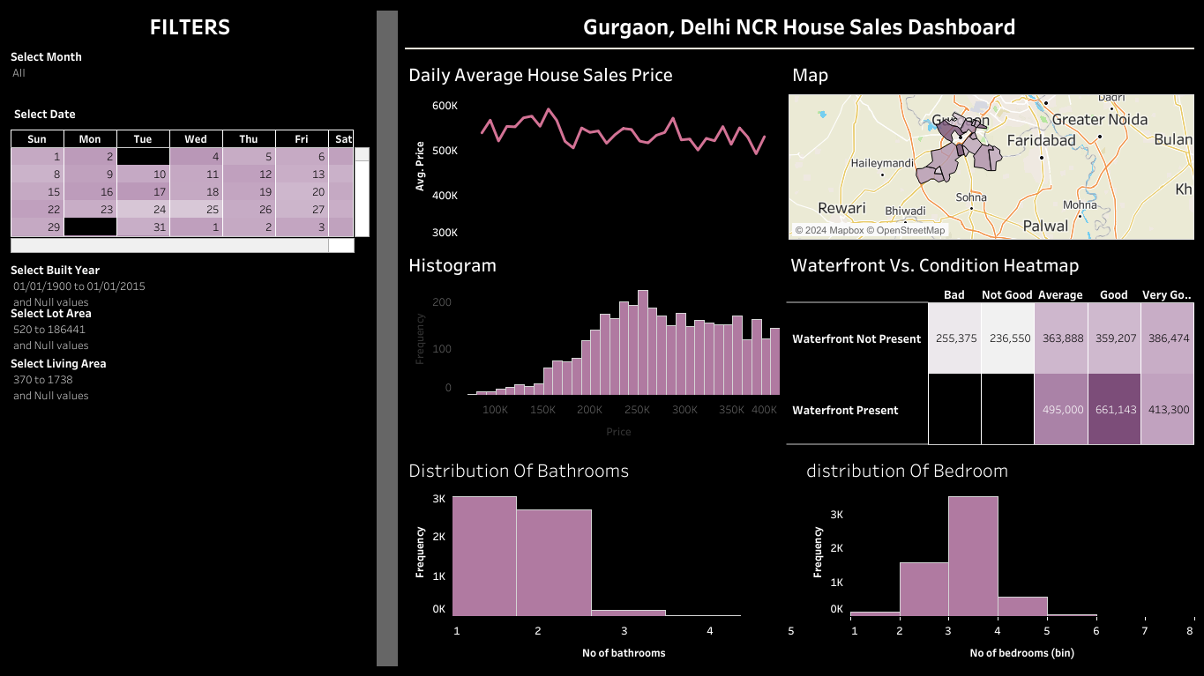
The Dashboard

Slide 11
Thank You!
Debojyoti Balial
dbalial@yahoo.com
9073395920
www.linkedin.com/in/debojyoti-balial

